Slide 1
Automated Panel Solar Unit
MECH Capstone Presentation
Prepared by Taylor Matson, Nathan Lamotte, and Nick Calin

Slide 2
Taylor Matson
Role: Project Manager
Project Manager for the automated solar panel unit.
Lead programmer and electrical engineer.
Concept designer.

Slide 3
Nathan Lamotte
Role: Project Designer
Project Designer
Fabricator
3D Printing

Slide 4
Nick Calin
Role: Project Documentation
Co-designer
Co-fabricator
Documentation Manager

Slide 5
Overview
Increase efficiency of solar input by tracking sunlight intensity and actuating the panel angle to react to shadows and weather.
Construction is made of standardized 1” x 1” aluminum extrusions, affordable off the shelf electronics, and 3D printed decorations.
Wireless connectivity allows for remote monitoring of the system.
A waterproof enclosure and several sealed connectors allows for 24/7 operation in all environments

Slide 6
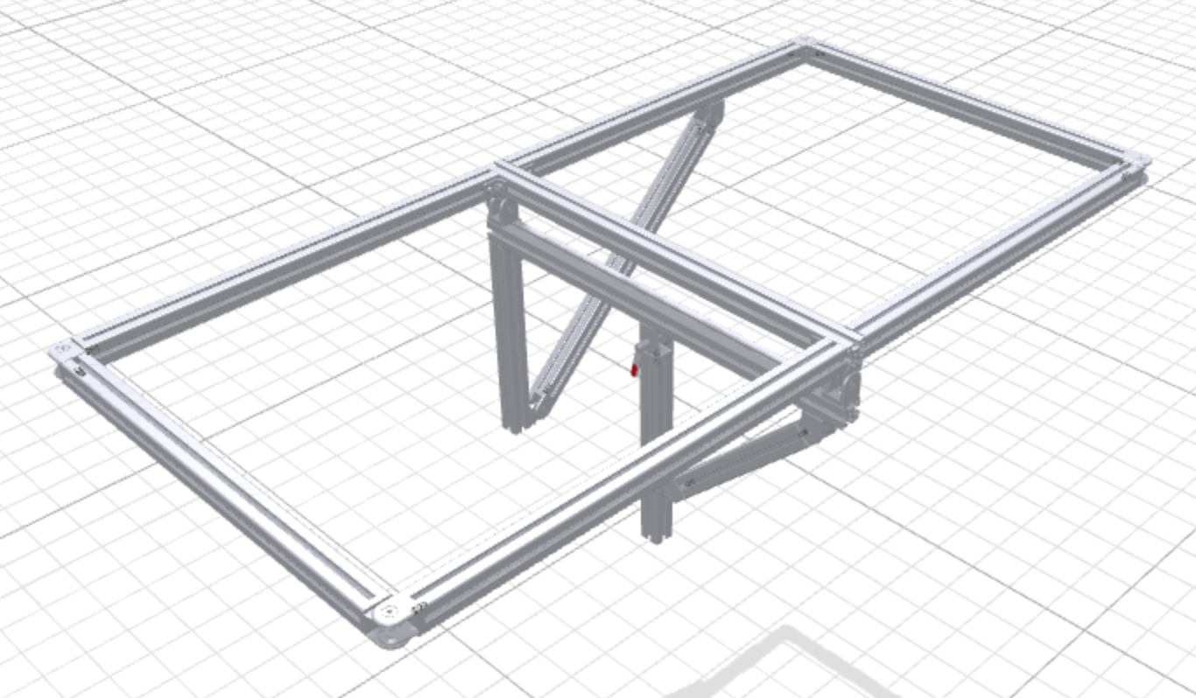
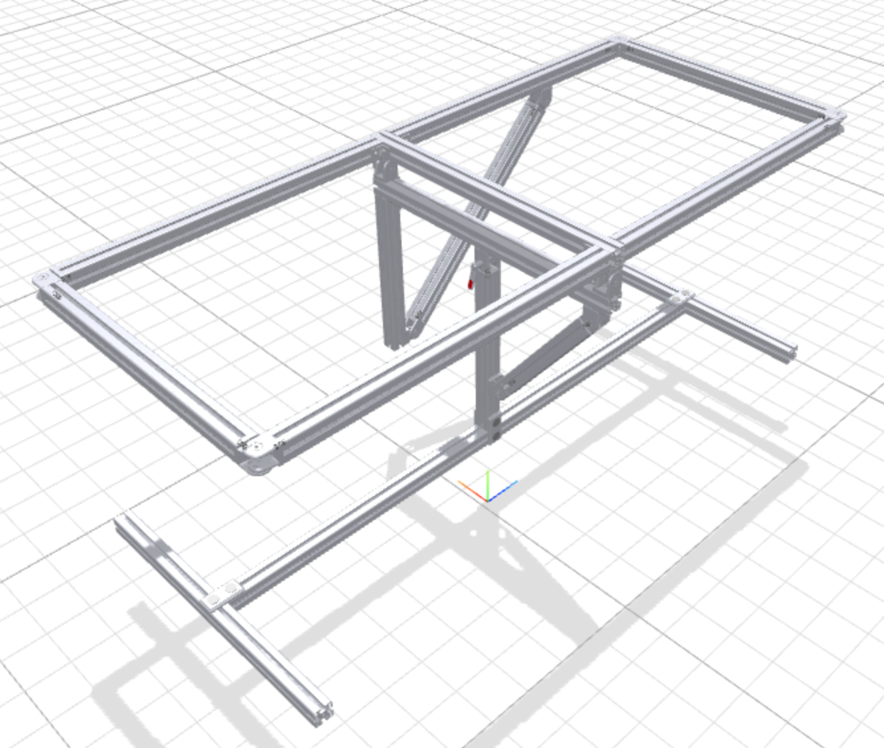
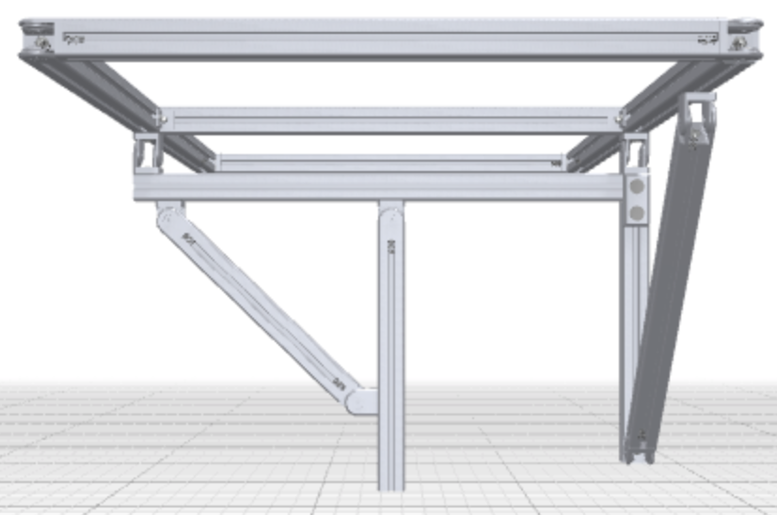
Concept Images

Slide 7
Project objective
The objective of A.P.S.U (Automated Panel Solar Unit) is to sustain power output for longer and more efficiently by using a self-contained, self-powered control system to automatically orient the panel to the brightest light source available.

Slide 8
A.P.S.U Operation
The system uses a 195W solar panel, 6” and 12” 12V DC actuator, Arduino Uno Wifi Rev 2, 4 Channel Relay Board, Solar Panel Controller, 12V battery, and four photoresistors.
The panel sends power to the solar panel controller, the controller then provides a charge to keep the battery full and a full-load output. The Arduino is powered from the battery, the relay board is powered by the Arduino, and the actuators are powered by the 12V lines from the relays.
The photoresistors mounted on each corner of the panel send a resistance value to the analog input on the Arduino where the values are compared, then based on instruction the corresponding relay is energized sending power to the actuator.

Slide 9
Understanding the problems
01
The aluminum extrusion framing is the thinnest available and in consequence has the most unstability.
02
The software for wireless connectivity is not well documented so a lot of experimentation is required.
03
For everything we wanted to include in our project the budget would need to be expanded to add more features, and functionality.

Slide 10
Problem 01
The first problem we ran into was the thin 1” x 1” aluminum extrusion which was used for the entire frame construction initially, but after assembly the weight of the panel caused the aluminum to flex and twist under load.
Solution:
To resolve this issue we decided to reconstruct the base using steel, we welded together 1” x 1” steel tubing in the original shape of the aluminum base but also added two more feet in the center to increase ground contact, this greatly increased stability.

Slide 11
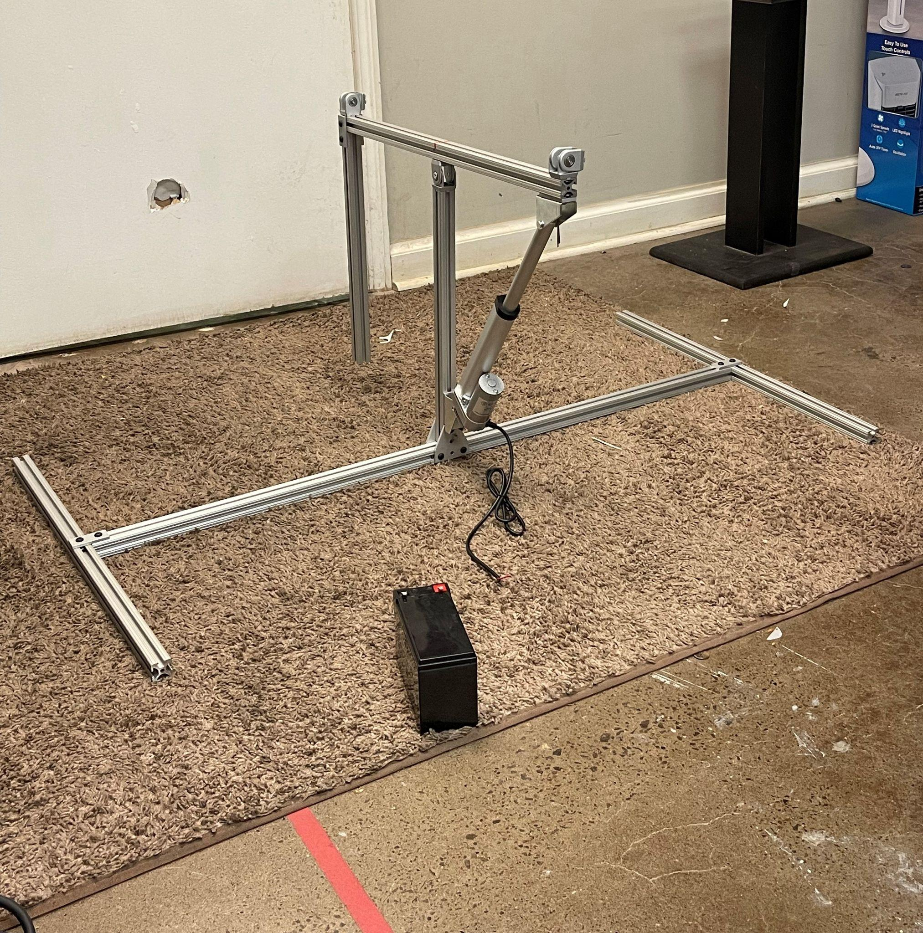
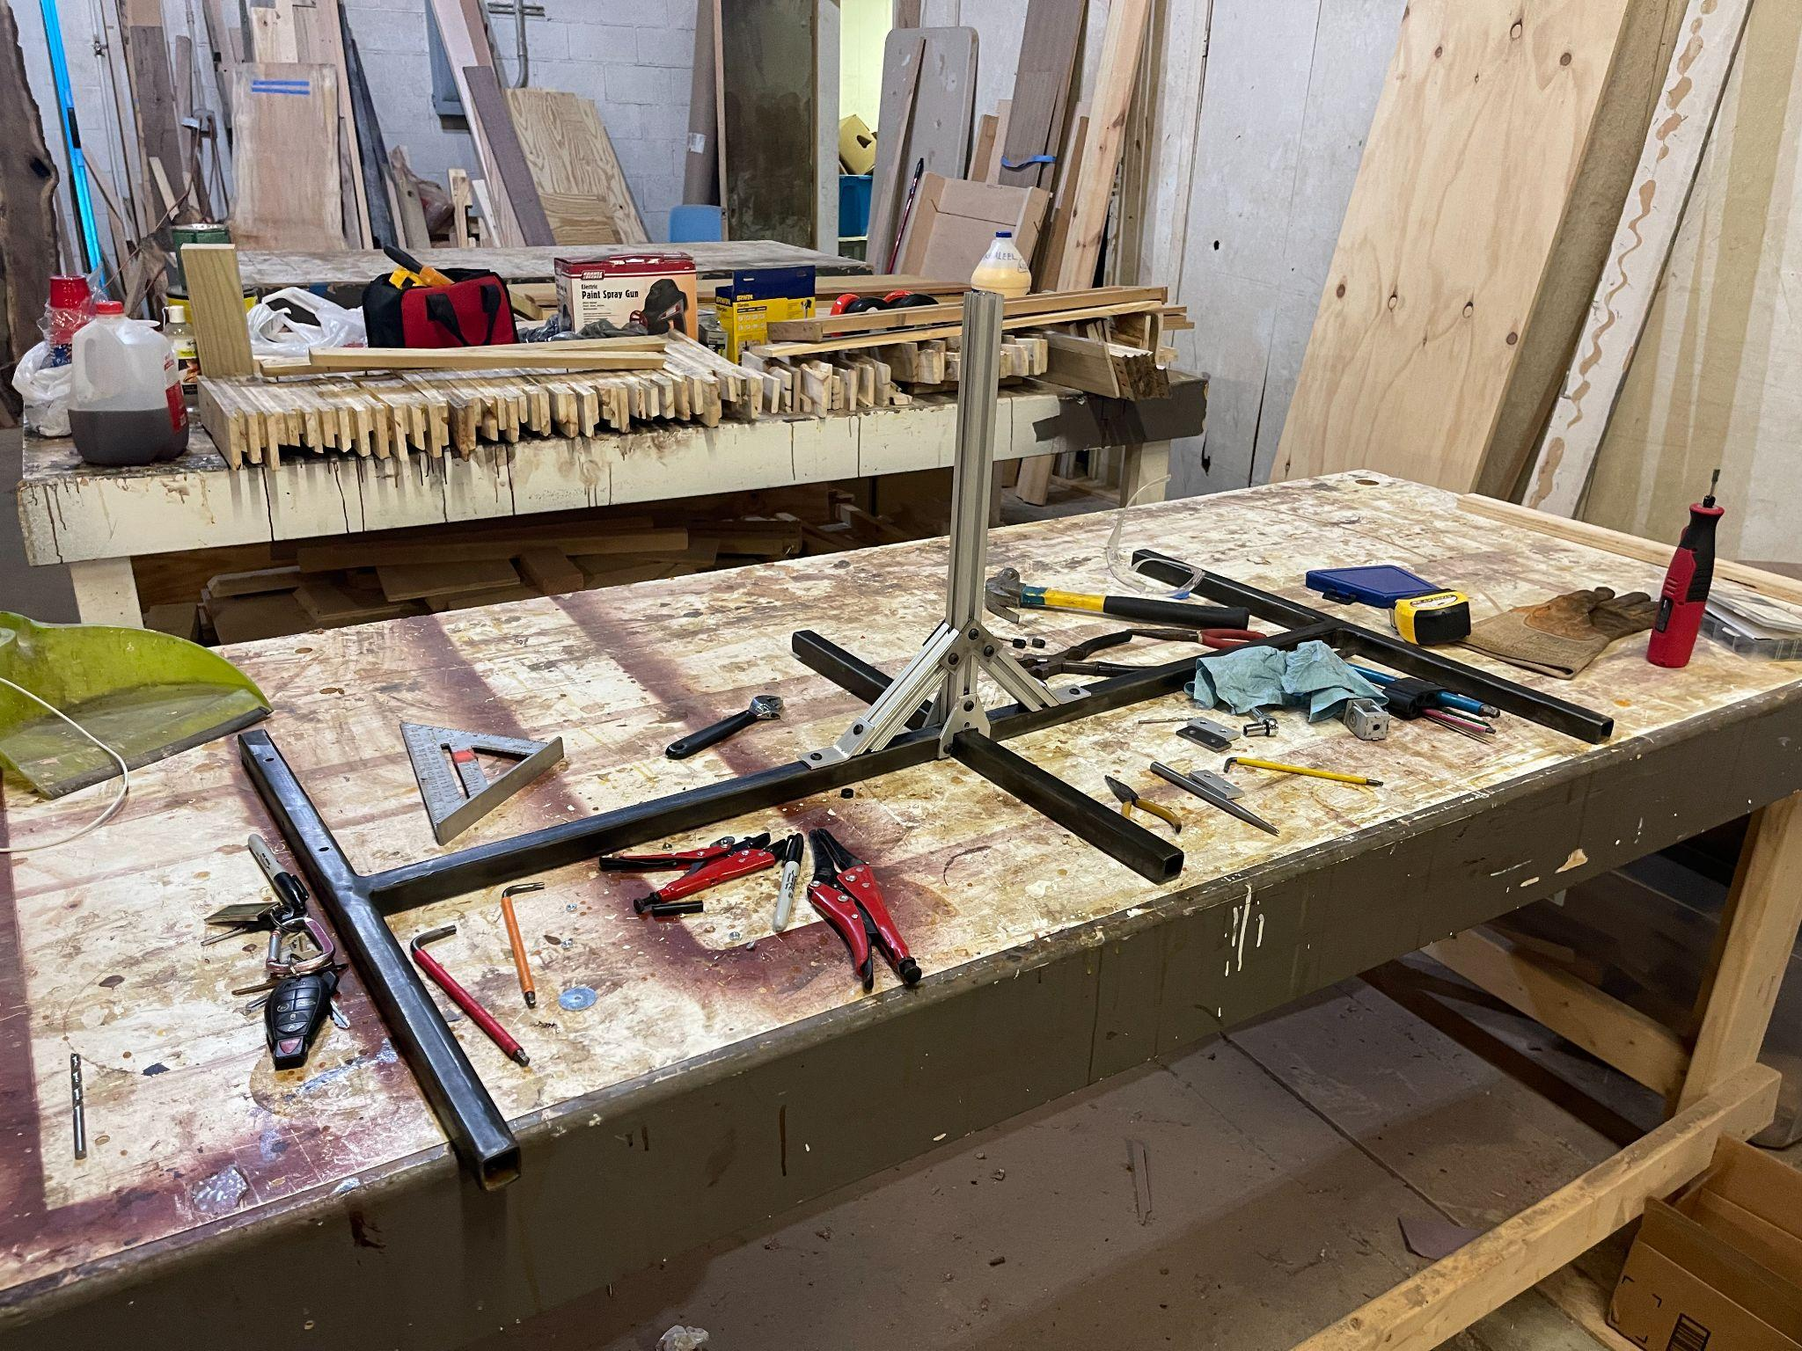
A.P.S.U. Frame Development

Slide 12
Problem 02
To satisfy the project requirement for wireless connectivity we wanted to interface the the control system with a wireless connection via WiFi or Bluetooth to monitor input data and change variable code within the RAM. Unfortunately Bluetooth is more complicated and less documented than WiFi.
Solution:
We settled on a WiFi solution that enabled us to change sensitivity levels and monitor data at a small expense to CPU processing capabilities on the Arduino.

Slide 13
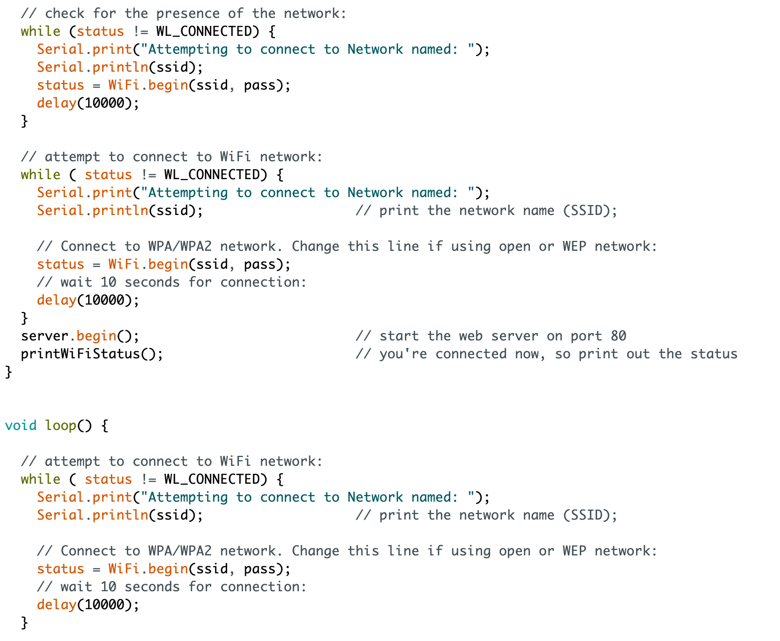
WiFi Code Snippet

Slide 14
Problem 03
For all the features we wanted to include into this project additional funds would be required, for example in the original concept, we wanted to interface GPS cordance into the microprocessor to be the primary means by which the panel aligns itself with the sun.
Solution:
To execute our project with the available funds, instead of using a GPS module to track the sun's position we used photoresistors mounted on each corner of the panel to calculate the brightest light available and align itself to that source.

Slide 15
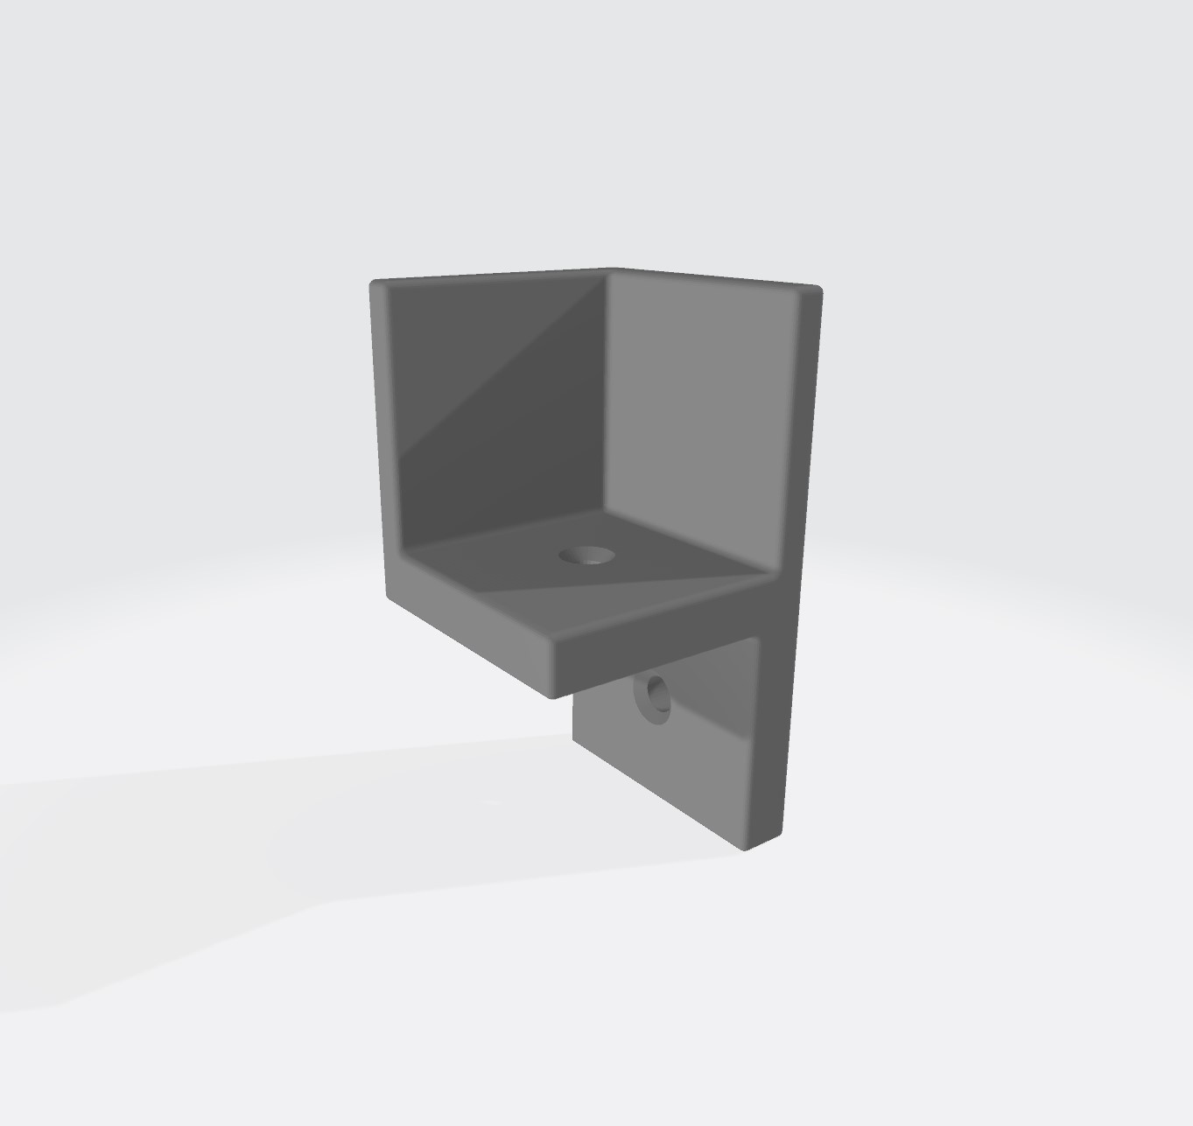
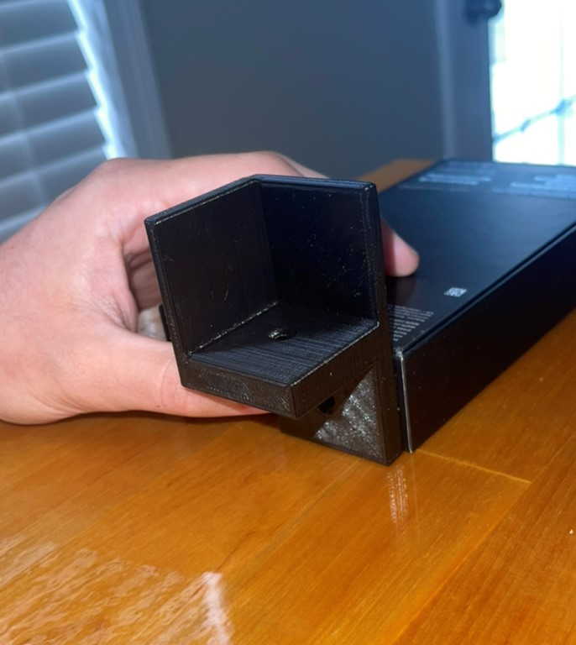
3D Printed Integrated Resistors

Slide 16
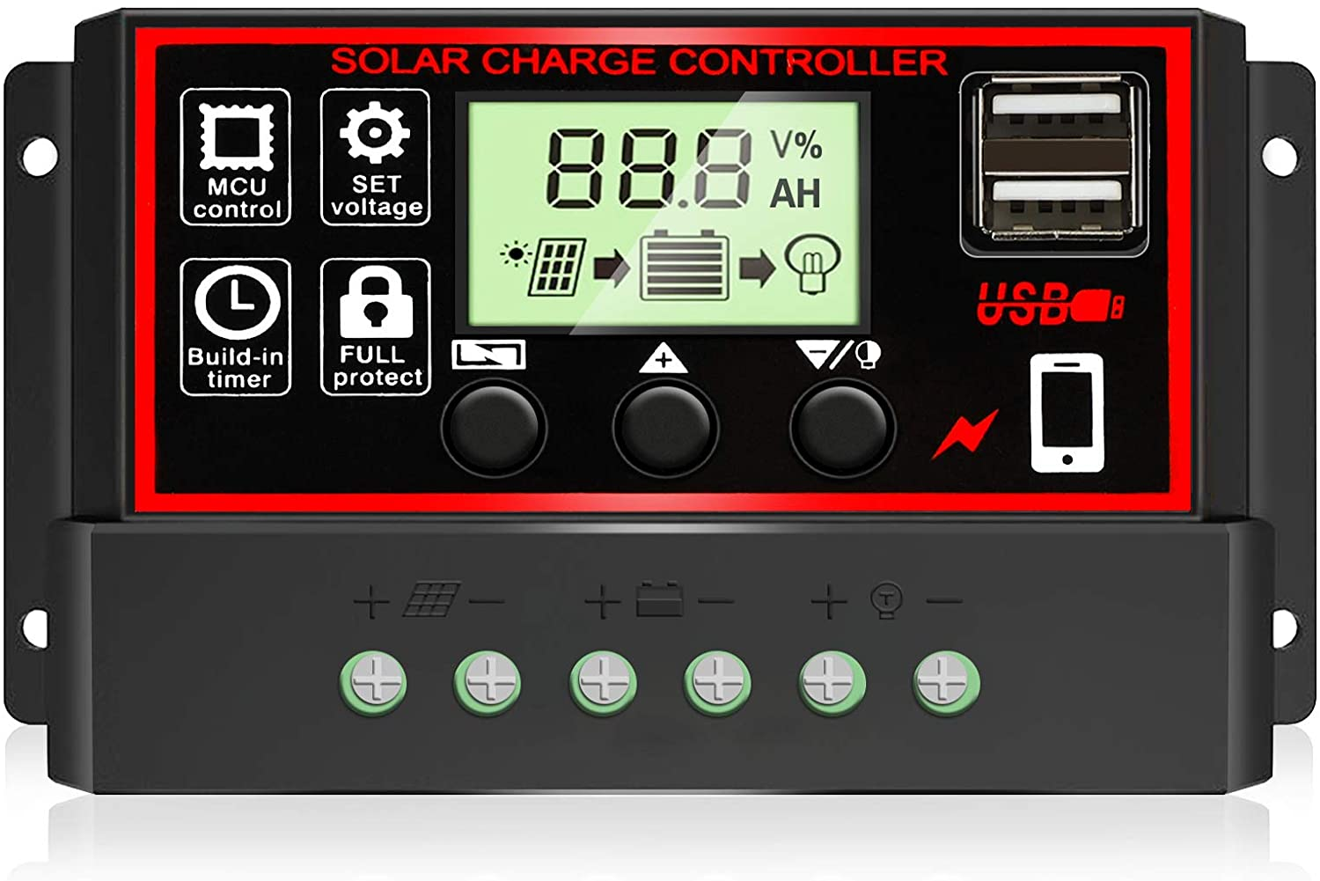
What We Are Surprisingly Satisfied With
The Solar Panel Controller - It takes the power, which varies by a lot (12V to 24V), and charges the battery at a steady 12V and powers the actuators at a steady 12V and is consistent with the 5V power supply the Arduino needs.
The quick response of the the system to light is also quite impressive, more so than what we were expecting.
Originally we did not expect the actuators to be connected to the Solar Controller but instead be connected directly to the battery. The Solar Controller makes power consumption from a solar that much more convenient for use.

Slide 17
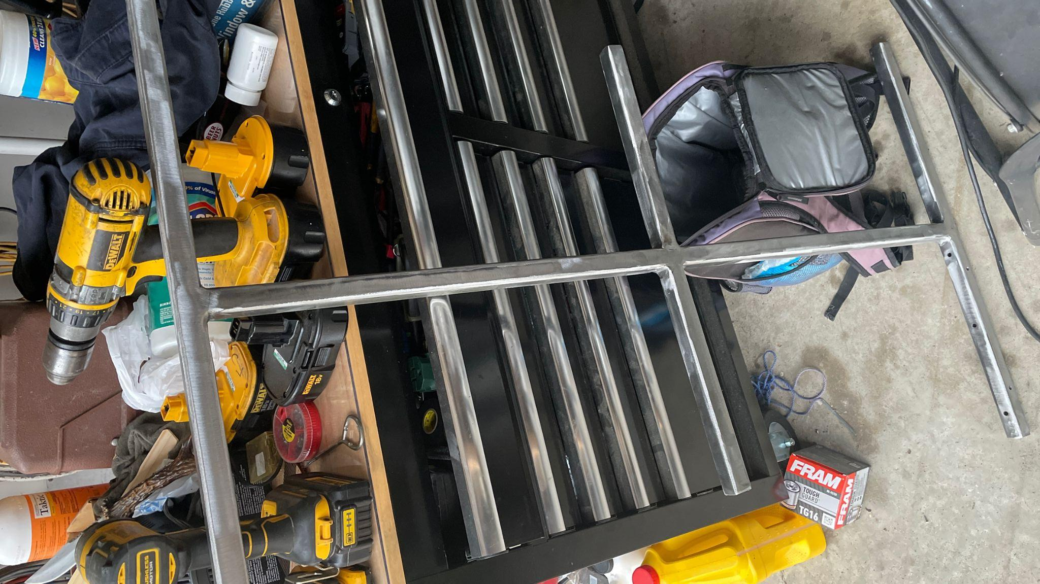
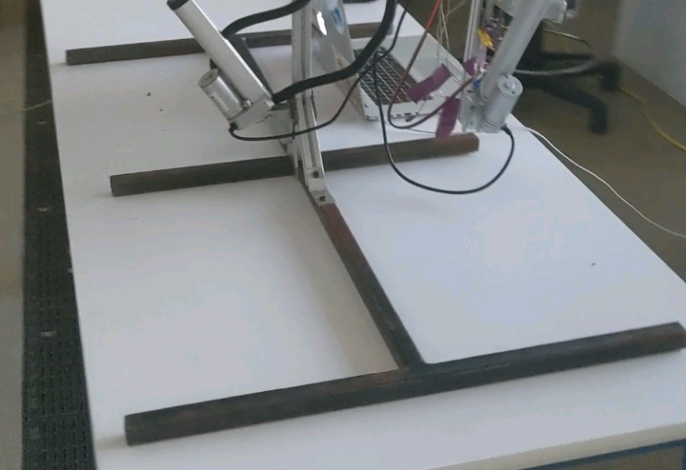
Urgently Needed Improvements
The Blueing Process: It was rushed and we didn’t have enough time to put on more coats so that it wouldn’t rust.
The WiFi Control/Monitoring: Something is preventing smartphone connectivity while laptop use is perfectly acceptable, our guess it that the Arduino response looks unsafe to cell phones.
Before Blueing: After Blueing:

Slide 18
Long Term Enhancements
Data Analysis of Power Efficiency
Bluetooth Low Energy Interactivity
Better Weather Proofing of Seals
120V Power Conversion
Better documentation for education and open sourcing
We see several opportunities with this project for further research in the solar power industry.
It can be proven that our system increases solar power input, more so than the power it uses.
This panel in effect is as effective as two Solar Panels pointed in two different directions
The ability for the panel to react in real time from objects blocking it to other power sources that become brightest in the local vicinity make the system highly adaptable, more so than any other tracker.
The research data that can come out of this will be beneficial to those who need to optimize the solar panels they already have.

Slide 19
Lessons Learned:
Communication is key to support team members and understand the progress being made.
Where some fail, redistribute tasks and re-assign or create new tasks better suited to the individual.
Make sure you put on multiple coats of blueing to prevent steel from rusting.
WiFi programming is much implement to use than Bluetooth low energy but the power consumption, features, speed is less that BLE.
It is better to buy a watertight enclosure than to build one.
Using crimp connectors instead of soldering is extremely fast in comparison and is the best when creating circuits for initial prototypes.
Do not mount a breadboard upside downs, the breadboard cables will slip out from vibration.
Photoresistors have a very noisy output, filtering them using a 4.7k Ohm resistor straightens the signal out.
A 3D model can be generated from a 2D image to be used for 3D printing.
10 Series Aluminum Extrusions are very flexible when the load of a 195W solar panel is mounted to it.

Slide 20
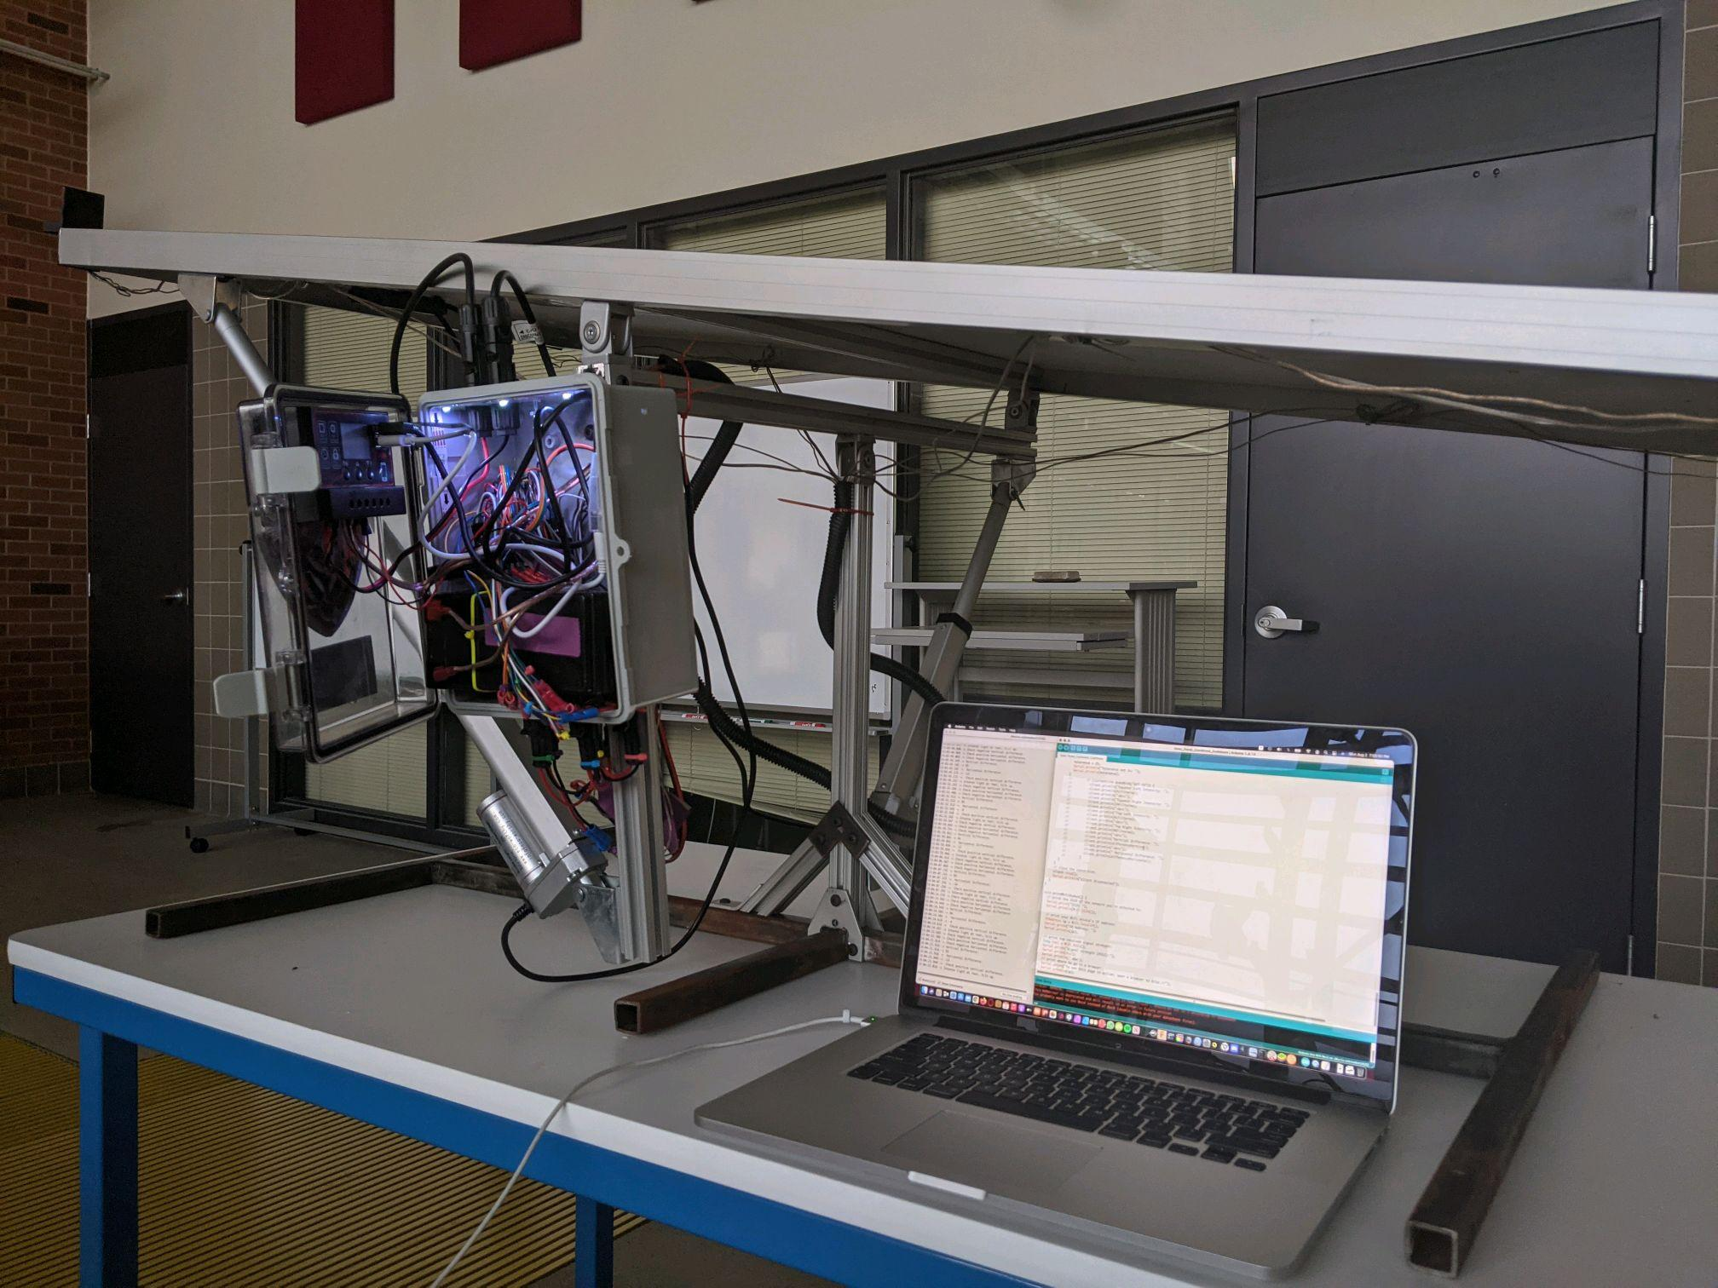
Conclusion
We had a blast bringing this project to life, we learned a lot along the way, in the future we hope to use A.P.S.U to power a FarmBot using 100% renewable energy.

